Slide 1
Topic 29:
Remote Sensing
29.1 Production and use of X-rays
29.2 Production and uses of ultrasound
29.3 Use of magnetic resonance as an imaging technique

Slide 2
MRI
Magnetic Resonance Imaging

Slide 3
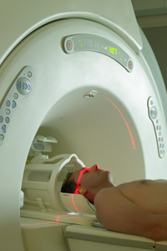
What is MRI
Magnetic Resonance Imaging, or MRI, is a painless and safe diagnostic procedure that uses a powerful magnet and radio waves to produce detailed images of the body's organs and structures.
It produces very clear images especially of the soft tissues.
It is the method for detecting the smallest of abnormalities in the body.
It is the preferred method for examining the brain and spinal cord.
However, it is the most expensive and the duration of the scan is longer.

Slide 4
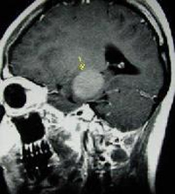
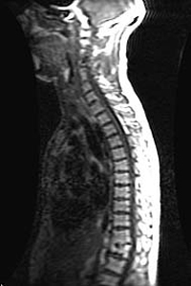
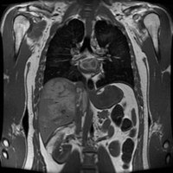
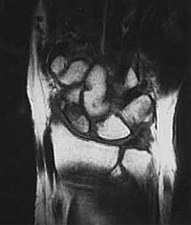
MRI Images
Upper Torso
Brain Tumour
Shattered Wrist Bones
Taken With Injected Contrast/Dye
Contrast agents or dyes may be injected or taken orally to highlight specific areas so that the organs, blood vessels, or tissues are more visible.

Slide 5
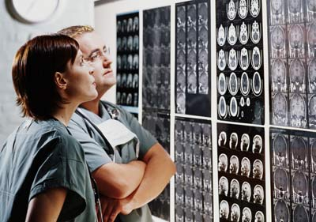
Ability of MRI Images
By changing exam parameters, the MRI system can cause tissues in the body to take on different appearances. This is very helpful to the radiologist (who reads the MRI) in determining if something seen is normal or not. For example, we can see the arterial system in the body without the tissues around it.

Slide 6
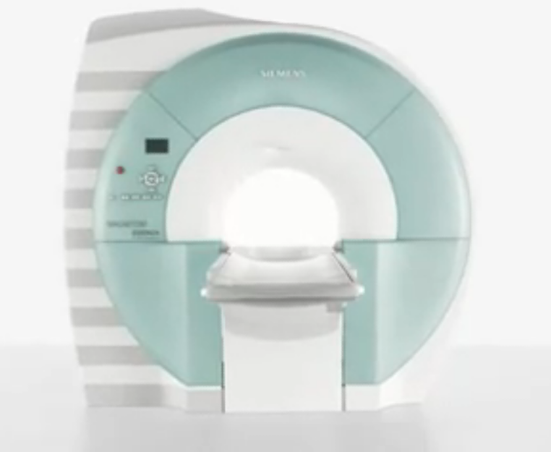
Understanding MRI
CLICK

Slide 7
MRI Not For Everybody
Certain people, however, may be unable to undergo the procedure. These include:
Those who have implanted medical devices, including heart pacemakers and inner ear implants.
Those with metal close to or in an important organ, for example a piece of metal in the eye possibly from an old injury, or metal clips in the brain following treatment for a brain aneurysm.
Pregnant ladies are advised against taking MRI as it has not been proven safe.

Slide 8
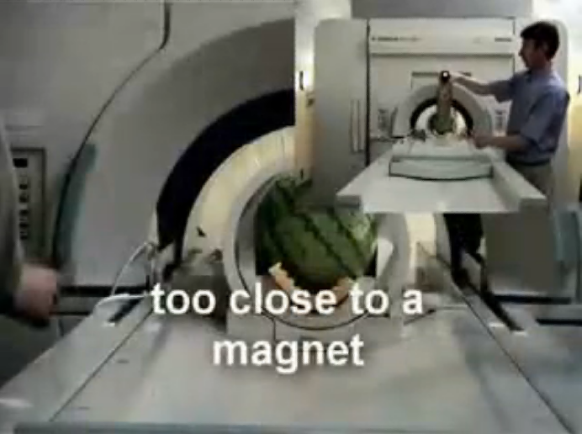
Danger of MRI
CLICK
Keep ALL metal objects away from the scan room. Paperclips, pens, keys, scissors, stethoscopes etc can be pulled out of pockets and off the body without warning, at which point they fly with high speed toward the opening of the magnet.

Slide 9
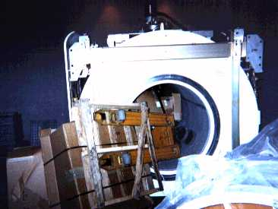
Very Strong Magnet
A fully loaded pallet jack sucked into the bore of an MRI system.
The magnetic field strength of an MRI system is 0.5 - 2.0 T.
Any credit cards or bank cards with magnetic information will be erased.

Slide 10
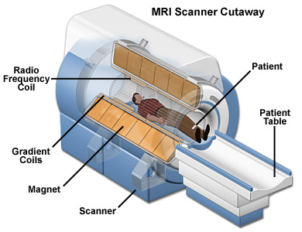
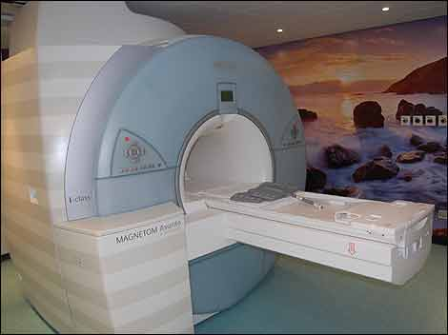
Structure of the Scanner
The cylindrical permanent magnet provides a stable uniform magnetic field.
The Gradient Coils provide a variable magnetic field.
The Radio Frequency Coil produces and detects radio frequencies.

Slide 11
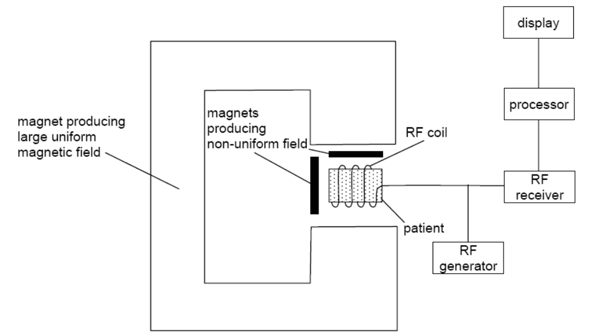
Block Diagram

Slide 12
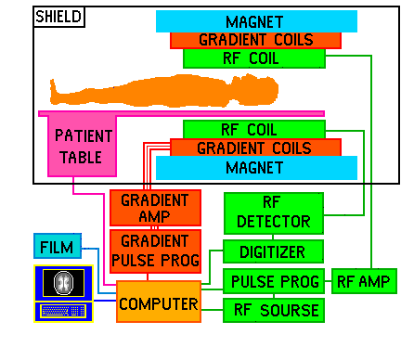
Block Diagram

Slide 13
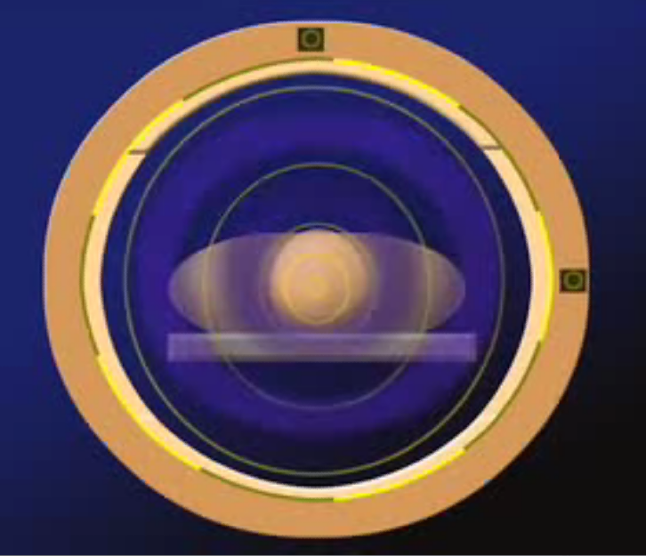
How MRI Works
CLICK

Slide 14
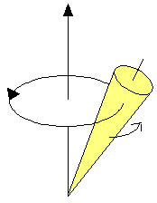
Precession
The human body is made up of untold billions of atoms, the fundamental building blocks of all matter.
The nucleus of an atom spins, or precesses, on an axis.
You can think of the nucleus of an atom as a top spinning somewhere off its vertical axis.
A top that is spinning slightly off the vertical axis is precessing about the vertical axis.

Slide 15
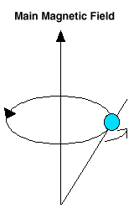
The Hydrogen Atom
Imagine billions of nuclei all randomly spinning or precessing in every direction.
There are many different types of atoms in the body, but for the purposes of MRI, we are only concerned with the hydrogen atom.
It is an ideal atom for MRI because its nucleus has a single proton and a large magnetic moment.
The large magnetic moment means that, when placed in a magnetic field, the hydrogen atom has a strong tendency to line up with the direction of the magnetic field.
A hydrogen atom precesses about a magnetic field.

Slide 16
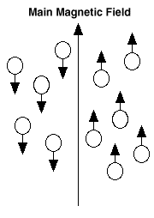
Unmatched Protons
Inside the bore of the scanner, the magnetic field runs straight down the center of the tube in which we place the patient.
This means that if a patient is lying on his or her back in the scanner, the hydrogen protons in his or her body will line up in the direction of either the feet or the head.
The vast majority of these protons will cancel each other out -- that is, for each one lined up toward the feet, one toward the head will cancel it out.
Only a couple of protons out of every million are not cancelled out. This doesn't sound like much, but the sheer number of hydrogen atoms in the body gives us what we need to create wonderful images.
In any sample there is one or two unmatched protons (not cancelled off)

Slide 17
The Radio Frequency (RF)
The MRI machine applies an RF (radio frequency) pulse that is specific only to hydrogen.
The system directs the pulse toward the area of the body we want to examine.
The pulse causes the protons in that area to absorb the energy required to make them spin, or precess, in a different direction. This is the "resonance" part of MRI.
The RF pulse forces them (only the one or two extra unmatched protons per million) to spin at a particular frequency, in a particular direction.
The specific frequency of resonance is called the Lamour frequency and is calculated based on the particular tissue being imaged and the strength of the main magnetic field.
These RF pulses are usually applied through a coil. MRI machines come with many different coils designed for different parts of the body: knees, shoulders, wrists, heads, necks and so on

Slide 18
The Gradient Magnets
The three gradient magnets are arranged in such a manner inside the main magnet that when they are turned on and off very rapidly in a specific manner, they alter the main magnetic field on a very local level.
What this means is that we can pick exactly which area we want a picture of. In MRI we speak of "slices." Think of a loaf of bread with slices as thin as a few millimeters -- the slices in MRI are that precise.
We can "slice" any part of the body in any direction, giving us a huge advantage over any other imaging modality. That also means that you don't have to move for the machine to get an image from a different direction -- the machine can manipulate everything with the gradient magnets.

Slide 19
Hydrogen Protons Release Energy
When the RF pulse is turned off, the hydrogen protons begin to slowly (relatively speaking) return to their natural alignment within the magnetic field and release their excess stored energy.
When they do this, they give off a signal that the coil now picks up and sends to the computer system.
What the system receives is mathematical data that is converted, through the use of a Fourier transform, into a picture that we can put on film. That is the "imaging" part of MRI.

Slide 20
Uses of MRI
MRI is recommended by doctors for the following:
Diagnosing multiple sclerosis (MS)
Diagnosing tumors of the pituitary gland and brain
Diagnosing infections in the brain, spine or joints
Visualizing torn ligaments in the wrist, knee and ankle
Visualizing shoulder injuries
Diagnosing tendonitis
Evaluating masses in the soft tissues of the body
Evaluating bone tumors, cysts and bulging or herniated discs in the spine
Diagnosing strokes in their earliest stages

Slide 21
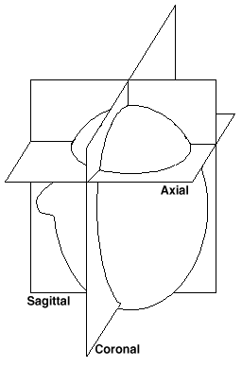
Advantages of MRI
The fact that MRI systems do not use ionizing radiation is a comfort to many patients, as is the fact that MRI contrast materials have a very low incidence of side effects.
Another major advantage of MRI is its ability to image in any plane. CT is limited to one plane, the axial plane (in the loaf-of-bread analogy, the axial plane would be how a loaf of bread is normally sliced).
An MRI system can create axial images as well as images in the sagitall plane (slicing the bread side-to-side lengthwise) and coronally (think of the layers of a layer cake) or any degree in between, without the patient ever moving.
If you have ever had an X-ray, you know that every time they take a different picture, you have to move. The three gradient magnets discussed earlier allow the MRI system to choose exactly where in the body to acquire an image and how the slices are oriented.
Axial, coronal and sagitall slices

Slide 22
Disadvantages of MRI
There are many people who cannot safely be scanned with MRI (for example, because they have pacemakers), and also people who are too big to be scanned.
There are many claustrophobic people in the world, and being in an MRI machine can be a very disconcerting experience for them.
The machine makes a tremendous amount of noise during a scan. The noise sounds like a continual, rapid hammering. Patients are given earplugs or stereo headphones to muffle the noise. The noise is due to the rising electrical current in the wires of the gradient magnets being opposed by the main magnetic field. The stronger the main field, the louder the gradient noise.
MRI scans require patients to hold very still for extended periods of time. MRI exams can range in length from 20 minutes to 90 minutes or more. Even very slight movement of the part being scanned can cause very distorted images that will have to be repeated.
Orthopedic hardware (screws, plates, artificial joints) in the area of a scan can cause severe artifacts (distortions) on the images. The hardware causes a significant alteration in the main magnetic field. Remember, a uniform field is critical to good imaging.
MRI systems are very, very expensive to purchase, and therefore the exams are also very expensive.

Slide 23
Future of MRI
The future of MRI seems limited only by our imagination. This technology is still in its infancy, comparatively speaking. It has been in widespread use for less than 20 years (compared with over 100 years for X-rays).
Very small scanners for imaging specific body parts are being developed. For instance, a scanner that you simply place your arm, knee or foot in are currently in use in some areas.
Our ability to visualize the arterial and venous system is improving all the time.
Functional brain mapping (scanning a person's brain while he or she is performing a certain physical task such as squeezing a ball, or looking at a particular type of picture) is helping researchers better understand how the brain works.
Research is under way in a few institutions to image the ventilation dynamics of the lungs through the use of hyperpolarized helium-3 gas.
The development of new, improved ways to image strokes in their earliest stages is ongoing.

Slide 24
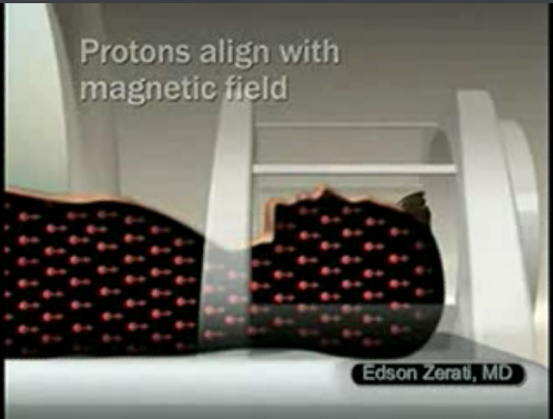
MRI Technology
CLICK

Slide 25
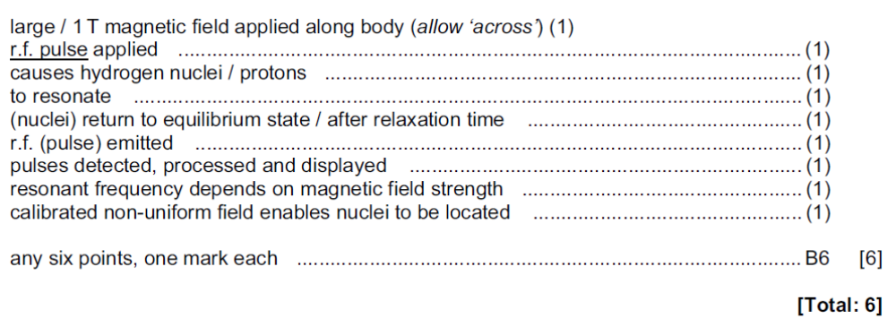
MRI (P41-Nov 2009)
Outline briefly the main principles of the use of magnetic resonance to obtain diagnostic information about internal body structures. [6]
Solution:

Slide 26
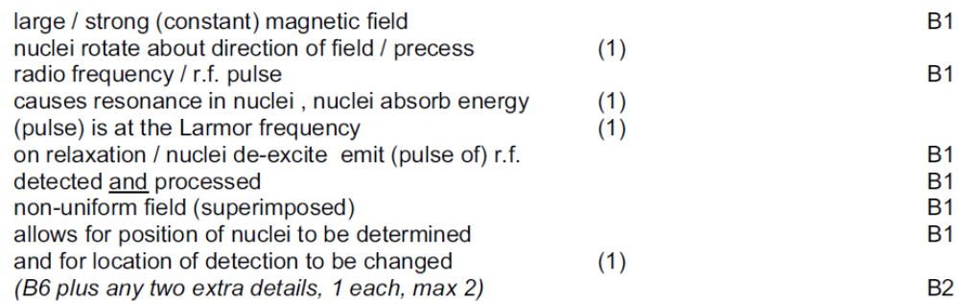
MRI (P4-June 2008)
Outline briefly the main principles of the use of magnetic resonance to obtain information about internal body structures. [8]
Solution:

Slide 27
The End

